Slide 1

HIV and periodic presumptive treatment of STIs in Papua New Guinea Christopher Rock John Murray and Richard Gray UNSW
Vacation Research Scholarships are funded jointly by the Department of Education and the Australian Mathematical Sciences Institute.

Slide 2
Talk layout
Title slide
Introduction
Model
Results & discussion
Conclusions
Acknowledgements

Slide 3
Intro
This is PNG
Location, size
HIV level
HIV
Uncurable, but can be suppressed
HIV death rate
Notes:
Could ask Richard for list of key donors

Slide 4
Ulcerating STIs and HIV
Some STIs make people more likely to receive or transmit HIV
Ulcerating STIs
Main ulcerating STIs in PNG
Viral vs bacterial
Syphilis, yaws, chancroid
How big is this effect
Some ulcerating STIs often don’t have symptoms

Slide 5
Periodic presumptive treatment
How it works
‘Presumptive’
‘Periodic’
Feedback
Problems
Expensive
Risk of drug-resistant bacteria
Stop-gap measure
HIV never observed to fall
We need to build a model
Notes:
Periodic – if you treat people once, STI levels go back up again

Slide 6
PNG HIV Model
Discrete, compartmental, deterministic homogenous mixing model to simulate HIV transmission
One input is USTI levels in each population – these are constant for the calibration period, but the model also allows for projections with different USTI levels

Slide 7
Model approach
Build a model for STIs
Feed into existing model for HIV
Bulk of my work went into simple model for STIs

Slide 8
Description of calibration stage
Demographic
86% in rural areas, 14% in urban areas
1% of rural women are FSW, 5% of urban women
4%/6% of rural/urban men are MSMW
UBSTIs in around 4% of population
1% lower in men than in women
15%-16% in FSW
1% higher in rural areas
Calibrated model by assuming UBSTIs are in equilibrium

Slide 9
Model – no PPT
Separate rural and urban model runs
Susceptible and infected proportions for each population

Slide 10
Prevalence equations (FSW given as example)
Treatment and loss rate
Infection rate
Maximum infection rate
Infection level among males

Slide 11
Infection rates in other populations
Proportion of males who aren’t MSMW
Proportion of sex acts performed by general females

Slide 12
Intervention description
PNG population has relatively high willingness to participate in health programs – Vallely, 2014 -> can assume relatively high coverage and retention rates
4 interventions targeting FSW – two coverage scenarios and two treatment scenarios
Interventions targeting all females, all males, whole population with half coverage

Slide 13
Intervention description
Infected overall is used in calculating infection rate for males

Slide 14
Prevalence equations with PPT (FSW)
PPT rate
Identical for infected and susceptible
Calculated as fraction of whole population, but only applied to susceptible or infected
Constant (memoryless) rate
Recovery rate
1/theta is expected duration of protection

Slide 15
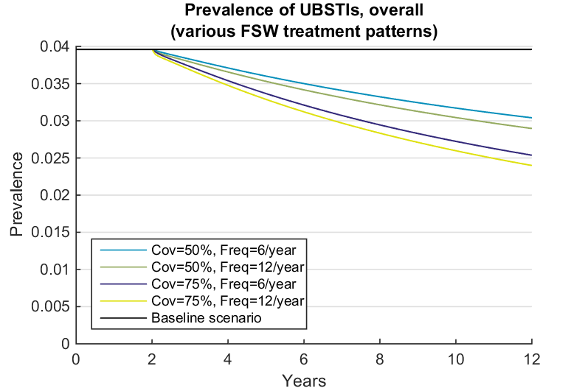
UBSTI results
Overall, there is a moderate decrease in STI levels at high coverages
Overall success rate is sensitive to coverage, but 6 PPT sessions per year seem to be enough (this also means that a non-systematic failure rate for treatment is tolerable)
We are only treating 1.5% of the population

Slide 16
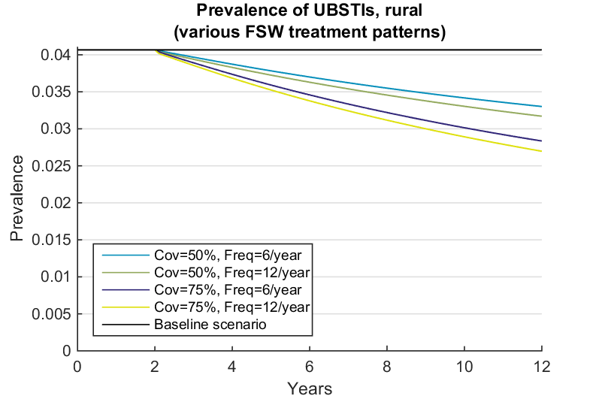
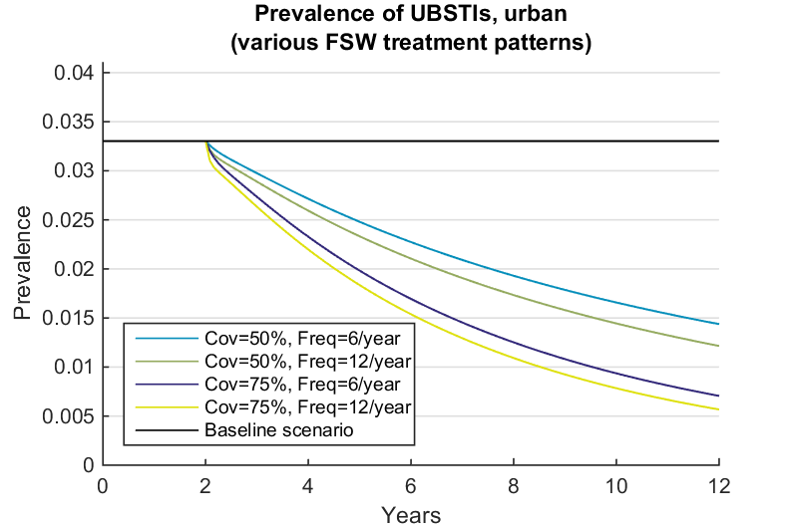
UBSTI results – breakdown by region
In rural setting, moderate amount of decrease
In urban setting, we are essentially wiping out UBSTI
More FSW in urban areas
FSW are more responsible for infection levels in urban areas

Slide 17
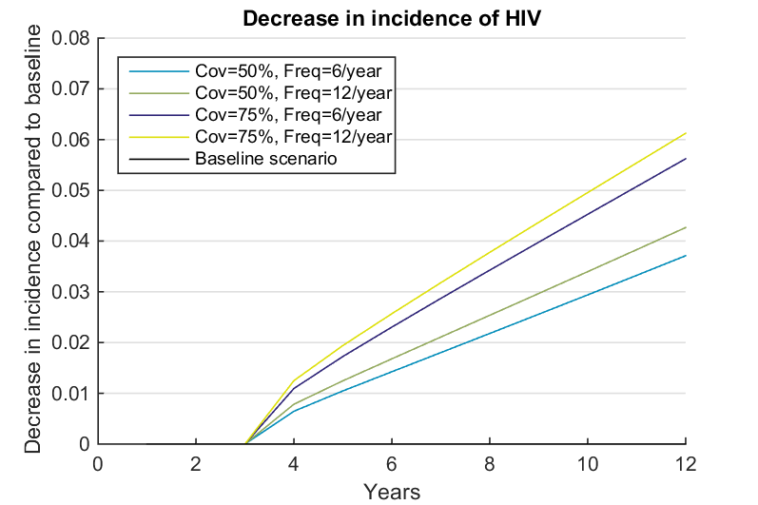
HIV results
Decrease of 4-6%.
Fairly low for the size of the project we’re considering
Measure incidence, not prevalence

Slide 18
Interventions into different populations
These interventions involve 25 times more people than the FSW interventions
May be easier to implement
Politically more appealing
Less stigmatisation of FSW as “unclean”
Reaching a smaller fraction of the whole population is easier than reaching a larger fraction of a sub-population

Slide 19
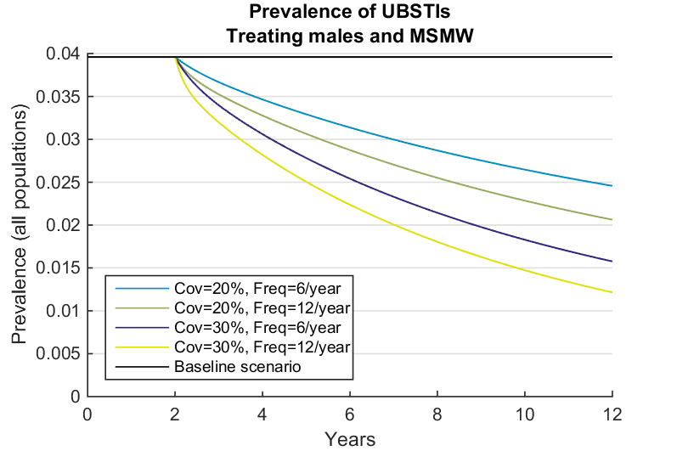
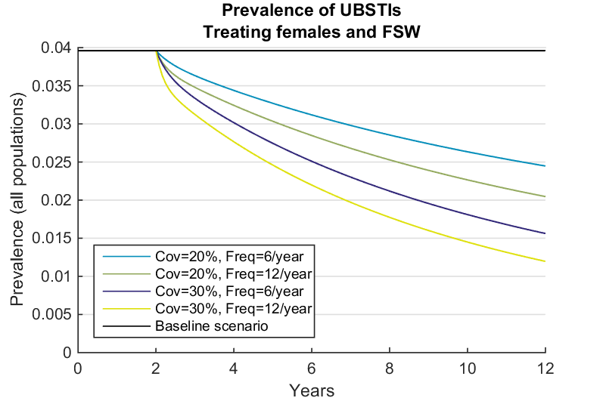
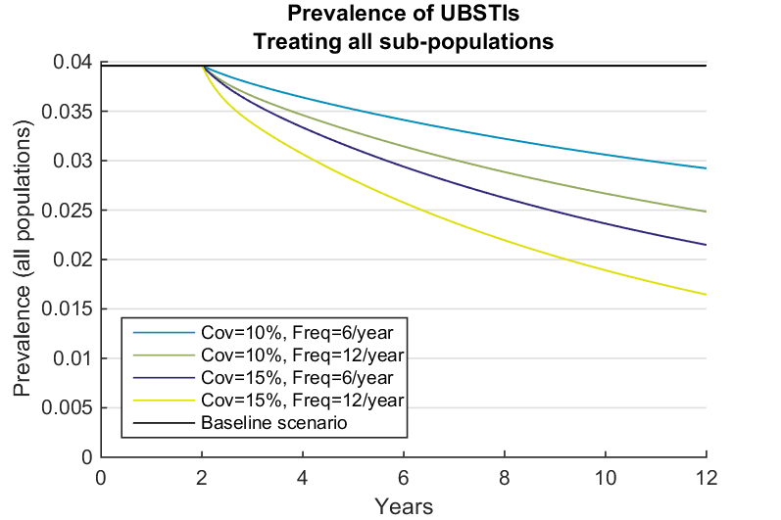
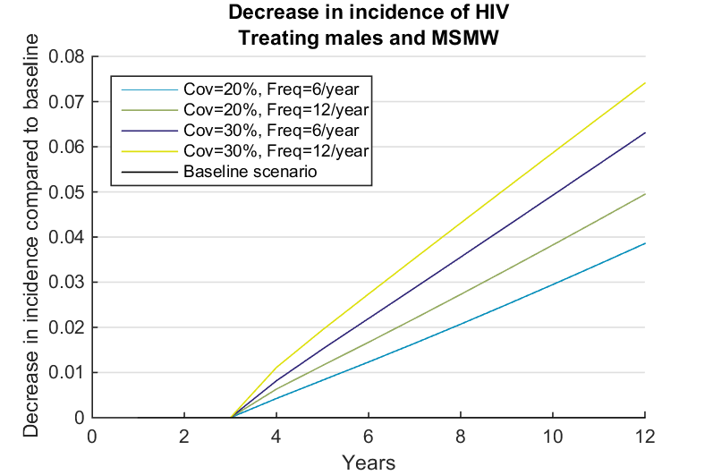
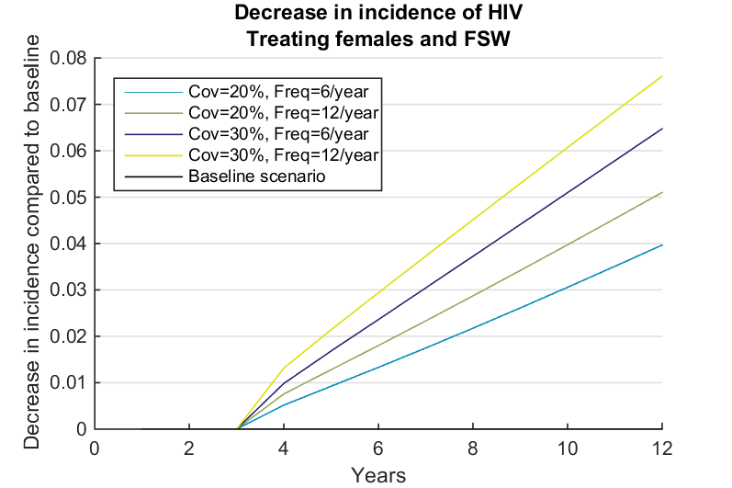
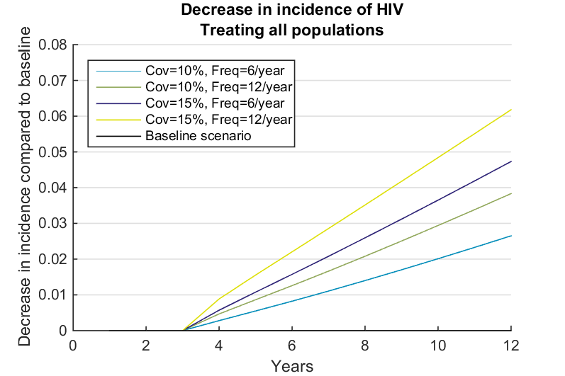
UBSTI results, interventions into different populations
Achieve a similar effect
Intervention for females has more effect – females have higher prevalence, so more often treatment is effective
More sensitive to frequency than FSW
Combined intervention much less effective

Slide 20
Possible extensions to model
Build integrated model with interaction between USTI and HIV
Include multiple USTIs
Include bridging populations
Include information about disease stages
Model explicitly for development of resistance

Slide 21
Possible extensions to model
Include death rates, migration, regional difference in treatment, condom use, explicit consideration of effect of mother-to-child transmission and ante-natal care, starting and stopping PPT, starting and stopping sex work, age structure of treatment and effect on age-varying partnerships

Slide 22
Recommendations
PPT could be effective in PNG in wiping out UBSTI in urban settings
PPT has moderate impact on HIV levels
Likely there are more effective ways to reduce HIV if this is only objective, but certainly provides additional benefit if trying to lower UBSTIs already
Could combine PPT with rapid tests for those UBSTIs for which there is a moderate failure rate
Complete model is justified

Slide 23
Acknowledgements
I would like to thank the Kirby Institute and the UNSW School of Mathematics for their support for this project, the Department of Education for sponsoring this program,and the Australian Mathematical Sciences Institute for sponsoring and organising the program. They did all the really hard work to prepare for this event - the maths is the easy part!

